Slide 1

Online Voting System
Arun K Nair (AM.EN.U4CSE18208)
Akshay A Menon (AM.EN.U4CSE18203)
Gokul Sriramanan k (AM.EN.U4CSE218)

Slide 2

INTRODUCTION
In "ONLINE VOTING SYSTEM" is an online voting technique. In this system people who are citizens and whose age is above 18 years of age and any sex can give his her vote online without going to any physical polling station.
In "ONLINE VOTING SYSTEM" a voter can use his her voting right online without any difficulty. He\She has to be registered first for him/her to vote manually. Registration is mainly done by the system administrator for security reasons.
After registration, the voter is assigned a secret Login ID and password with which he/she can use to log into the system and enjoy services provided by the system such as voting. If invalid/wrong details are submitted, then the citizen is not registered to vote.

Slide 3
Why Did We Choose The Topic ?
The Online voting system (OVS) also known as e-voting is a term several different types of voting embracing both electronic means of counting votes.
It can also involve transmission of ballots and votes via telephones, private computer networks, or the internet.
Online voting is an electronic way of choosing leaders via a web driven application.
In today’s world, a well known pandemic has increased due to social activities. This application targets on social activity which drastically increased the number of covid patients. Elections conducted nowadays has no control. The COVID protocols are never obeyed. This application is a online E-voting system which enable every person to vote at their respective houses and will substantially decrease the number of persons diagnosed with COVID.

Slide 4
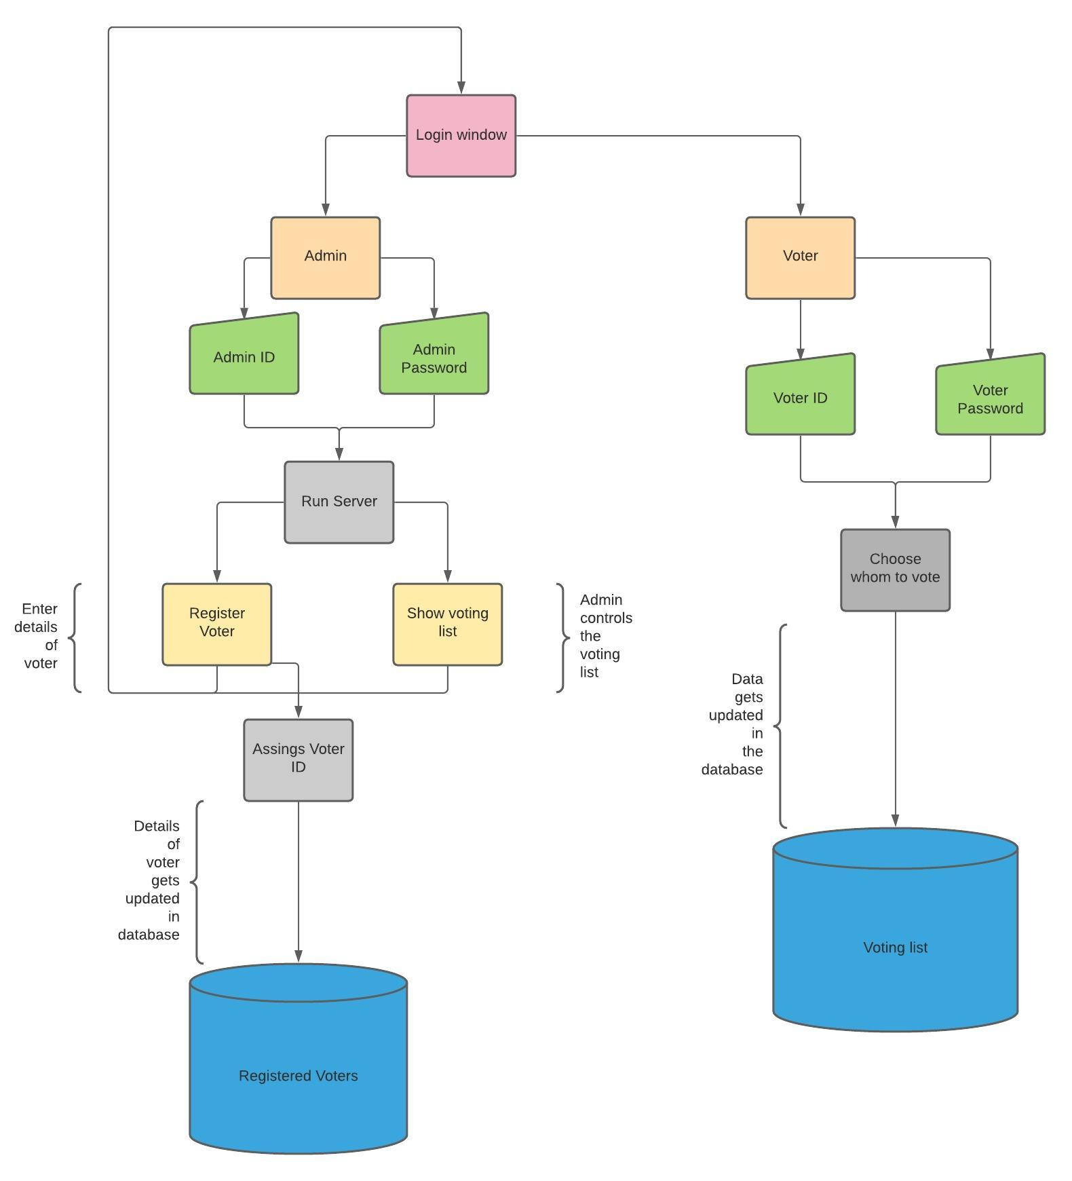
Data Flow Diagram

Slide 5
Concepts Implemented
The concepts implemented in this projects are:
Socket Programming using TCP and,
Multithreading using python modules

Slide 6
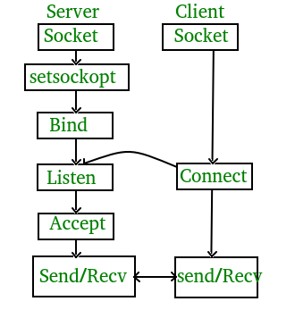
TCP Server-Client Connection

Slide 7
Python Code
def voting_Server():
serversocket = socket.socket()
host = socket.gethostname()
port = 4001
ThreadCount = 0
try :
serversocket.bind((host, port))
except socket.error as e :
print(str(e))

Slide 8
print("Waiting for the connection") serversocket.listen(10)
print( "Listening on " + str(host) + ":" + str(port))
while True :
client, address = serversocket.accept() print('Connected to :', address) client.send("ConnectionEstablished".encode())
t = Thread(target = client_thread,args = (client,)) t.start() ThreadCount+=1

Slide 9
Project Demo

Slide 10
Namashivaya

